Slide 1
Lost in transition: Challenges in domestic financing for HIV and human rights
24 July E105-108 14:30 - 16:00

Slide 2
To give birth and die: What happens with HIV treatment adherence after birth among women in Russia?
Elena Shastina, Julia Godunova, Anna Yakovleva, Elizabeth King
Irina Evdokimova, Nataly Sukhova, Elena Titina, Daria Legchilova
The Association E.V.A. Russian Federation

Slide 3
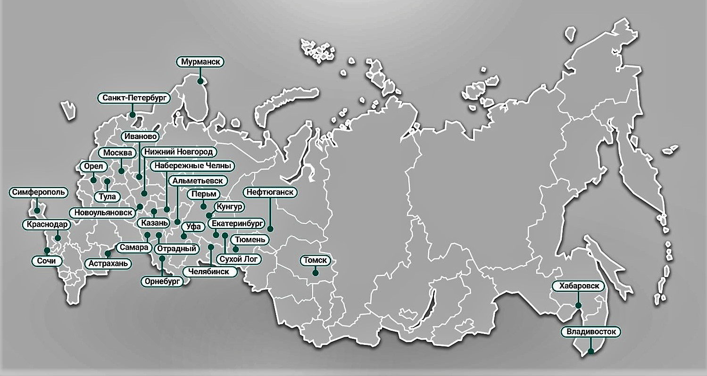
EVA Association is the first non-governmental network organization in Russian that was established to protect women who are affected by the HIV epidemic and other socially significant diseases
EVA unites 69
Activists from 29 Russian regions

Slide 4
Background
There is a feminization of HIV in Russia
The proportion of women among PLHIV has been increasing since 2002 and is currently 37%
Women are often diagnosed during pregnancy
Treating HIV is easier through prenatal care - PMTCT
Unknown factors influencing retention in HIV care and treatment (HCT) after pregnancy
This study determined factors influencing ARV adherence among HIV-positive women after childbirth

Slide 5
In phase one: 2 Russian regions – in-depth interviews with WLHIV and service providers
About the study
July 2016 – November 2017
Mixed-methods
Structured questionnaire partly self-completion
Diversity based on ARV use, history of injection drug use and / or sex work, and geographical location
HIV-positive women participated in the study design and administration of the survey

Slide 6
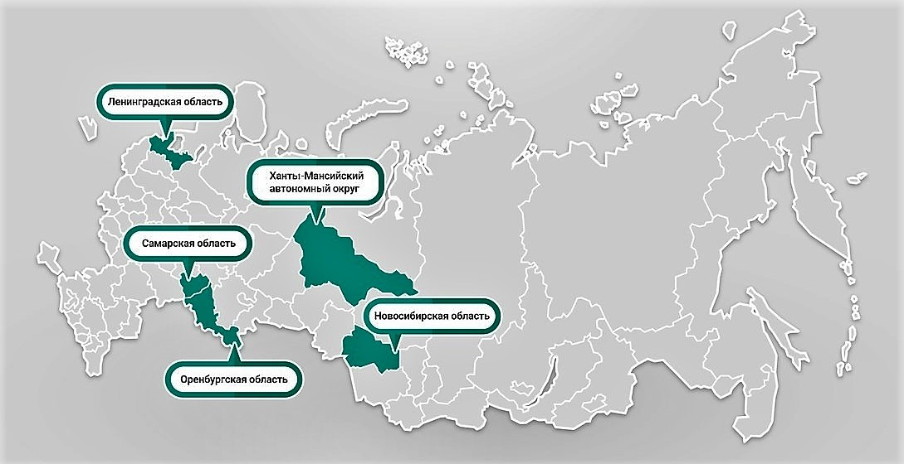
In phase two: 5 Russian regions – a higher HIV prevalence among women and higher incidence rates of HIV overall
About the study
200 HIV-positive women
Aged 18-42 years
Discovered their HIV status before or during pregnancy
Gave birth during the past 24 months

Slide 7
Results
36% of women diagnosed with HIV during pregnancy
Feelings of isolation, stigma, and fear associated with HIV and with motherhood were common

Slide 8
Results
Psychosocial support is devastatingly low
Lack of counseling has adverse effects on HCT retention
Only 27% received post-test counseling

Slide 9
Results
Women voiced the need for counselors who can explain the details of their diagnoses and medications
80% of women who had not received pre-test counseling during pregnancy reported skipping doses or stopping ARVs postpartum

Slide 10
Results
Taking pills twice daily and side effects were especially difficult postpartum
25% lacked support from care providers when experiencing harsh side effects

Slide 11
Results
Some health care providers also hold the idea that ARV use is solely to protect the future child and don’t encourage women’s longer-term use
The majority of women don’t connect ARV with their own health but rather with the goal of PMTCT

Slide 12
Results
The majority of women expressed grave financial need, lacking money for food or housing
Women mentioned lack of childcare, specifically for when they visit the doctor
Financial hardship was associated with poor ARV adherence
30% of respondents had lower incomes
Did not have access to social services

Slide 13
Results
Women with strong family and/or partner support valued its importance for retention in care
Single mothers, mothers afraid to disclose their serostatus to family, and mothers married to AIDS denialists are especially vulnerable to stopping treatment
Attitudes towards the value of their own health, family support, and motherhood-related factors played a significant role in adherence to treatment

Slide 14
Unexpected result
In our family we are forbidden to pronounce the word "HIV"...
I'm afraid to contact the police after being beaten because everything will be against me…
Domestic violence
Physical
Sexual
Economic
Psychological
He doesn’t like condoms…
I already have 4 children…
Tomorrow I will have an abortion…

Slide 15
Conclusion and recommendations
Programs to improve adherence for HIV-positive mothers should be universal and incorporate
Clarifications on effect of antiretroviral medications
Shaping the value of one's own health
Skills to support it (nutrition, regimen, sobriety)
Strengthen social support
Work with the entire family
The study showed no significant influence of factors associated with time, place, or conditions of HIV diagnosis on ARV adherence after birth; nor were there any regional differences

Slide 16
Thank you for attention!
Elena Shastina
shastinaev@gmail.com
+79878510480

